Slide 1
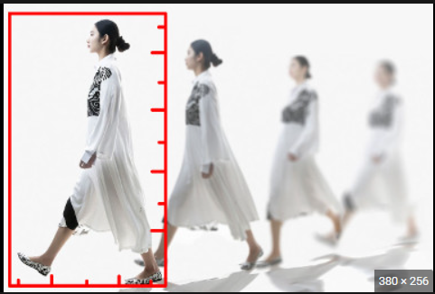
Gait Detection
Mila Marinković

Slide 2
Overview
Gait capture and visualization (gait detection, point capture, display of points on video)
Pose estimation - a complex Computer Vision problem that aims to detect the position and orientation of a person or object
Done by predicting the location of specific keypoints (hands, facial features, etc.), when talking about human position
OpenPose - very slow compred to MediaPipe(a long time to process videos and takes a lot of computing power even on decent machines)
Yolo - a single-stage multi-person keypoint detector
MediaPipe - a single-person pose estimation framework
MediaPipe produces good results on low-resolution inputs compared to YOLOv7.
It is faster and good at detecting far-away objects

Slide 3
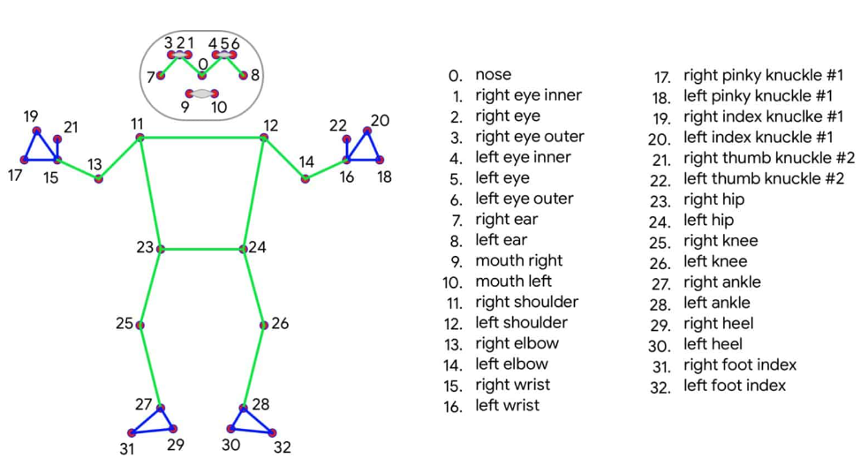
Goals
Pose estimation in each video (MediaPipe - landmarks with 33 landmark points)

Slide 4
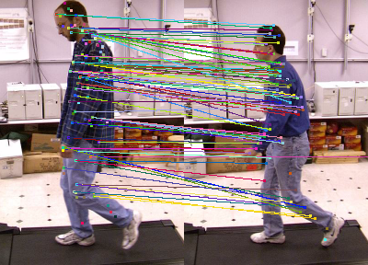
Goals
Merge/concatenate 2 videos in 1 video
Connect landmark points of 2 persons
Implement SIFT algorithm for more landmark points

Slide 5
Achieved goals
Play video

Slide 6
TODO
Add more landmarks points in each video and connect them with other persons specified landmark points
Various algorithms such as SIFT,SURF,ORB
Try each of them and choose the best one

